Slide 1
OceanStor™-Digital X Rack: A dHCI Kubernetes solution with full-stack enterprise features for modern banking infrastructures
®
Futurewei IT Solution Team

Slide 2
Trends
Open banking needs
Application needs
OceanStor, DaoCloud Digital X, and the digital journey
Opportunities and Challenges
Digital X Rack solutions
OceanStor-Digital X
Rack Solution

Slide 3




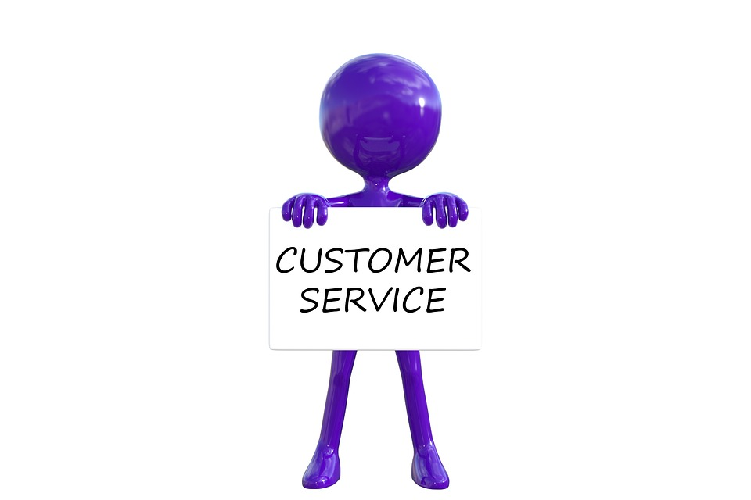


Trends of the Banking Industry
Digital full-service experience
Bank 3.0/
Bank 4.0
Banking service anytime, anywhere
App integration
Traditional branches
Basic Online Banking
Bank1.0/
Bank2.0
Notes:
4.0：客户体验，智慧认知---银行业务7*21小时贴身随行
移动互联，随时随地，高并发

Slide 4


Opportunities
Digital transformation
Open banking
Fintech and financial innovations
Challenges
Slow TTM and lack of application agility
More complex infrastructure and business continuity
Optimization of ROI and TCO
Talents and culture for future banking

Slide 5
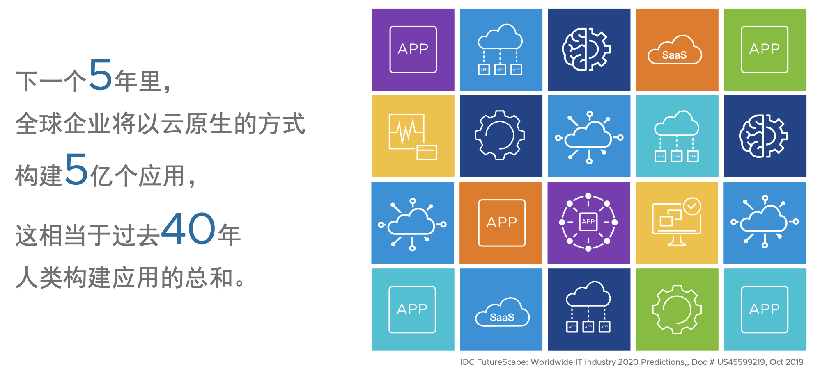
The Proliferation of Modern Apps
In the next 5 years, there will be totally half billions cloud native applications created for enterprises, equal to number of applications created in last 40 years!

Slide 6

Open banking
Customer App layer
Travel
Game
E-commerce
Media
Banking
FinTech
Open API layer
Payment service
Loan service
Wealth management
Product service
Data Insight
Financial Service product layer
RegTech
Common component layer
Core banking
Document images
Anti-fraud
Anti-Laundering
Big data analytics
Market trading
Reporting
Risk Management
General Ledger
Regulation compliance
Infra services in the industry
Credit report and verification systems
Fund payment systems
Credit Card networks
Stock/mercantile exchanges

Slide 7
Three main pillars of
Cloud-native Applications
Process
DevOps
Architect
Microservices
Modern
Application
+
The digital service capabilities by DaoCloud, is to help and ensure our enterprise customer could be fully inspired, motivated and modernized their digital journey, by leveraging the DevOps process, Microservices Architecture on the containerized cloud.
We believe that a systematic perspective is key to unlocking ambitions from the ground to speed up the journey.
Cloud
Container

Slide 8
「Cloud Native」is best practice for business digitalization
Cloud Native Characteristics
Resilient
Robust
Self-Governance
Observable
CNCF Cloud Native Definition v1.0

Slide 9
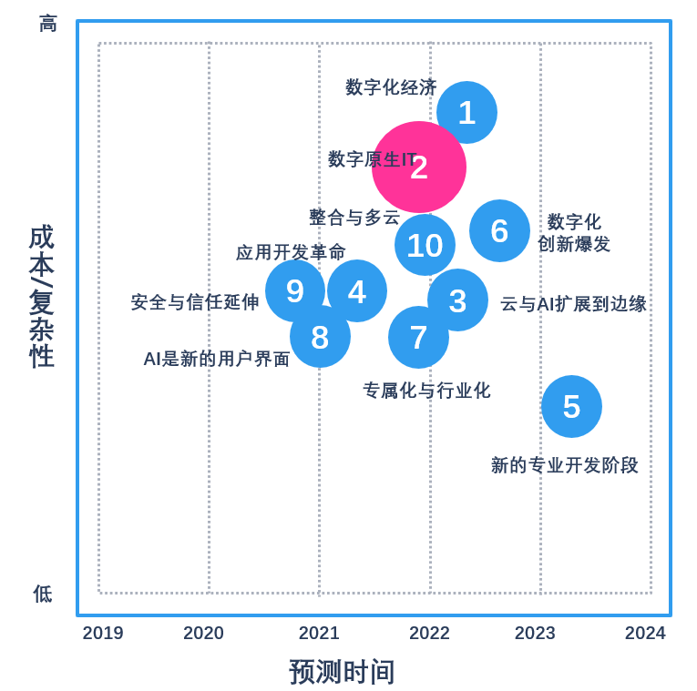
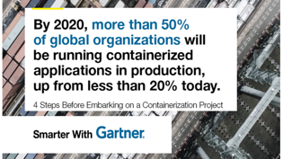

Cloud native becomes major trend for cloud computing
IDC®：By 2022，70% of new application will adopt microservice architecture. 35% of production application will be cloud native. By 2023, more than 90% enterprise digital economy will come from digital native IT environments.
Gartner®：By 2020，more than 50% global enterprise organization has adopted container technologies in their production applications
Google®: runs all their production application in container environments, there are more than 2 billion containers running. There are 3000 containers started per seconds.
IT departments add more business values more than ever through cloud native
Business Requirements
Architecture Standardization
Development Standardization
Environments Standardization
Operation Standardizations
• DDD
• Decouple
• Component
• Governance
• Fail Fast Design
• Observability
• Design
• Planning
• Development
• Testing
• Source control
• Deployment
• Rollover management
• Release management
• Configuration control
•Scheduling
• Orchestration
• Competitiveness and Marketing Activity
• New Product and Service
• Customer experience and innovation
• Customer interactive
• Integration
• Deployment
• Operation
• Package
• Trace
• Collaboration
• Automation
• Runtime
• Discovery
• Registry
• Service Catalog

Slide 10
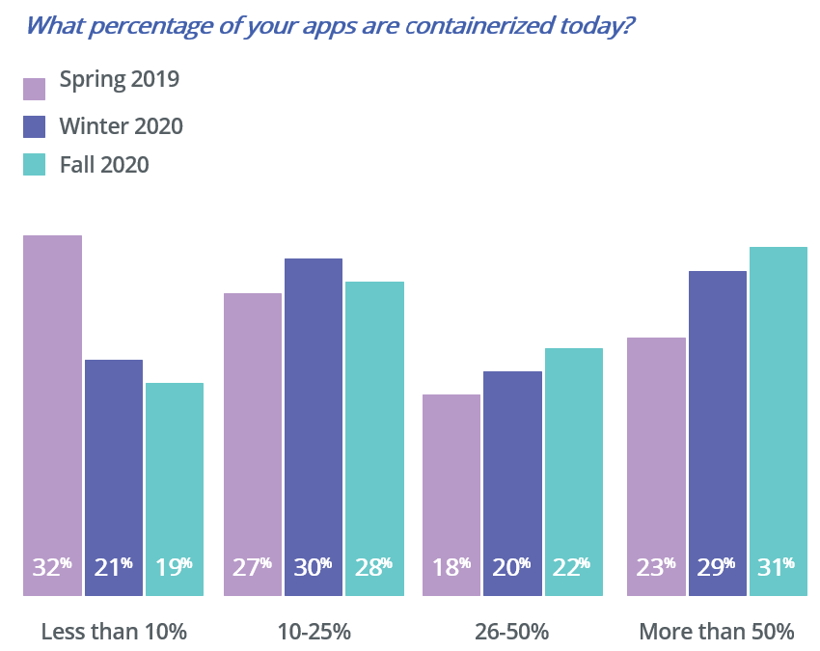
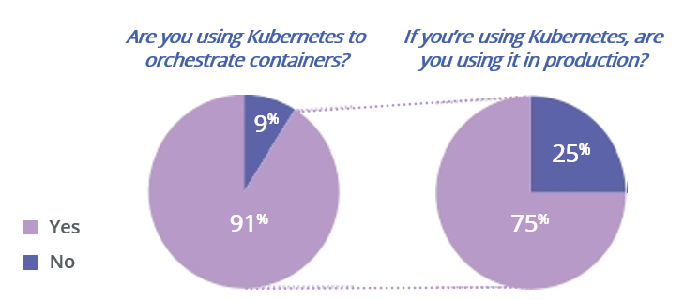
Customer Application Containerization Trend

Slide 11
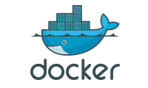







Enterprise IT Infrastructure Evolution
Enterprise IT 1.0, IT 2.0 to IT 3.0 Era- Cloud Native Era
IT 3.0
Cloud Native
Dev
Ops
计算虚拟化
分布式存储
SDN
安全虚拟化
DevOps
MacroService
Container
Cloud Native Architecture
IT 2.0
Cloudification
Agile
Vertical Architecture
VMs
X86 Architecture
IT 1.0
Server
Waterfall
Monolithic Architecture
Physical Machines
Mainframes
Development Process
Application Architecture
Delivery Model
Infrastructure Architecture

Slide 12
OceanStor, DaoCloud Digital X, and the digital journey
Opportunities and Challenges
DaoCloud Rack solutions
OceanStor-Digital X
Rack Solution
The rack solution
What’s inside
Application DR needs
DR solution
Multi-DC solution

Slide 13
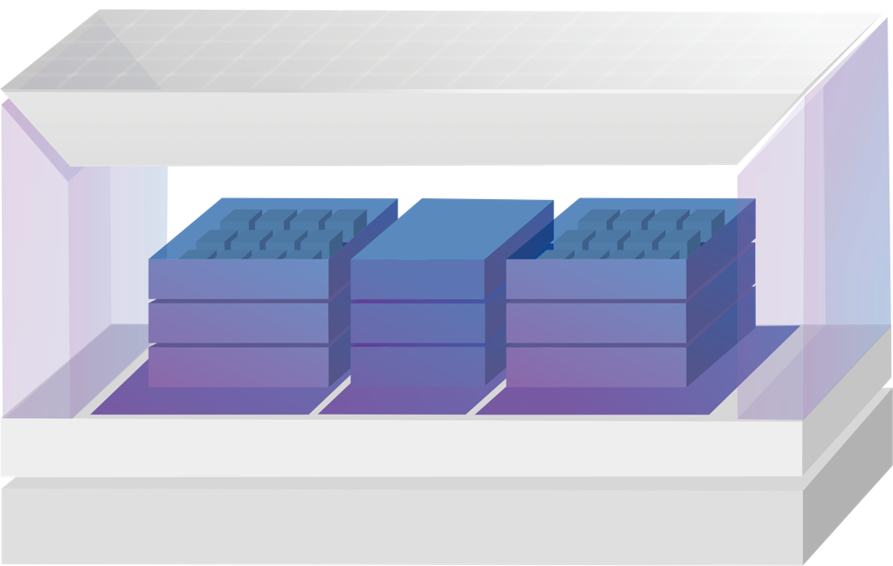








OceanStor-Digital X rack solution
Enterprise cloud-native platform
Cloud Mesh
Cloud collaboration
Microservice govenance
DevOps support
Enterprise Kubernetes® and cloud-native platform
Customer
Basket
Promotion
Verified for mission critical applications
100% native Kubernetes compatible
Network enhancement via CNI plug-ins
Support Major Linux distributions
Transaction
Product
Order
Traffic
Stock
Logistic
Enterprise compute stack
Cloud Engine
Different CPU/mem configurations
Support major VMs
Compute Infra
Enterprise switches (Multi-switch for redundency)
Bare Metal
Virtualization
VXLAN
TRILL
FCoE
Network Infra
CloudEngine data center switches
Enterprise Storage (99.9999% reliability)
SmartDedupe
SmartCompression
SmartVirtualization
SmartMigration
SmartThin
SmartQuota (NAS)
SmartMulti-Tenant (NAS)
SmartCache
SmartTier
HyperSnap (SAN & NAS)
HyperClone (SAN & NAS)
HyperCDP (SAN & NAS)
HyperReplication (SAN & NAS)
HyperMetro (SAN & NAS)
Storage Infra
OceanStor Enterprise storage array
(Converged for SAN and NAS )

Slide 14
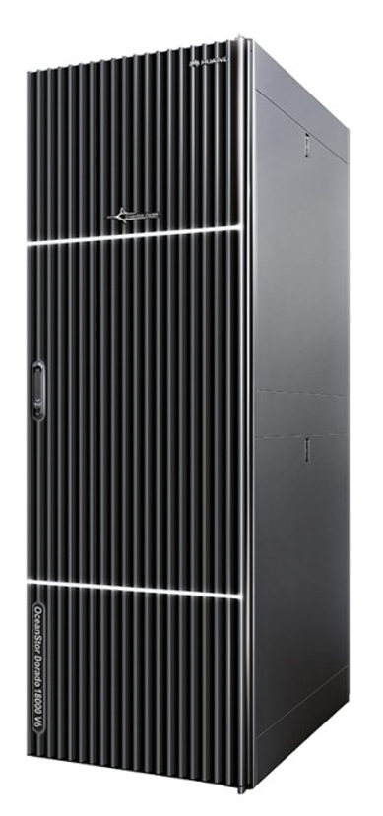
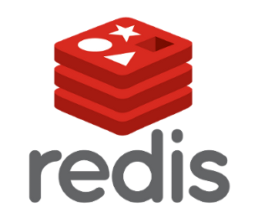

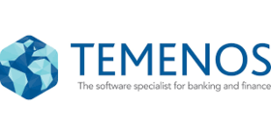
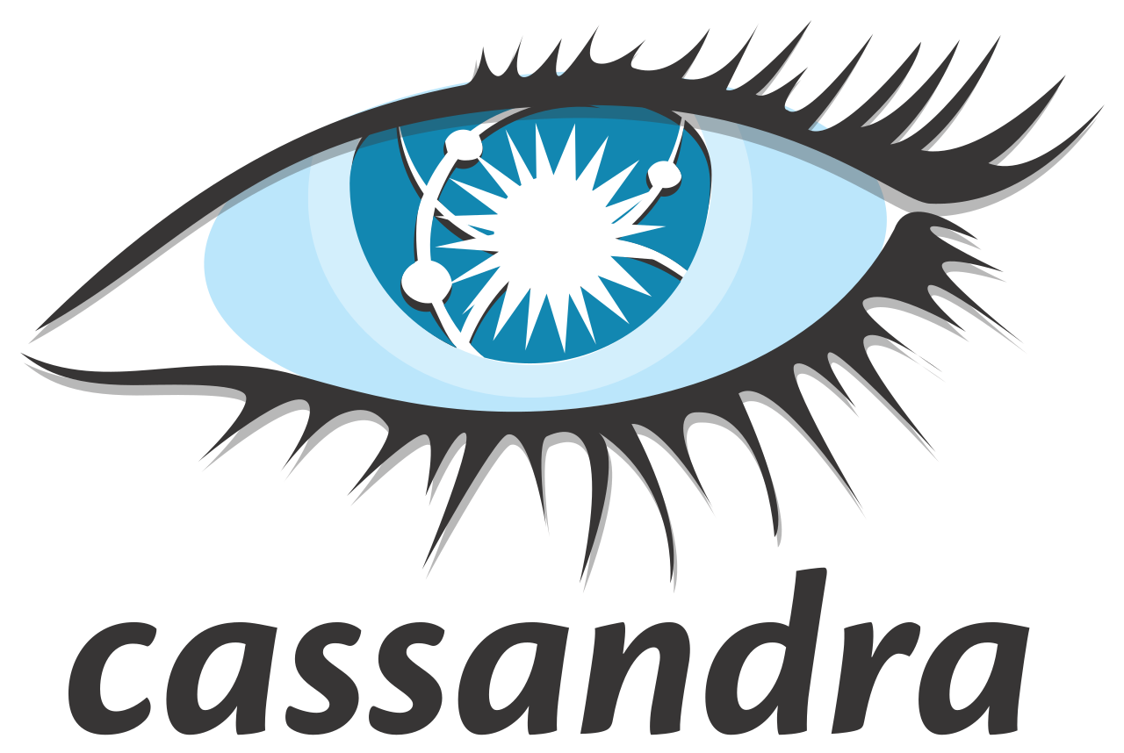
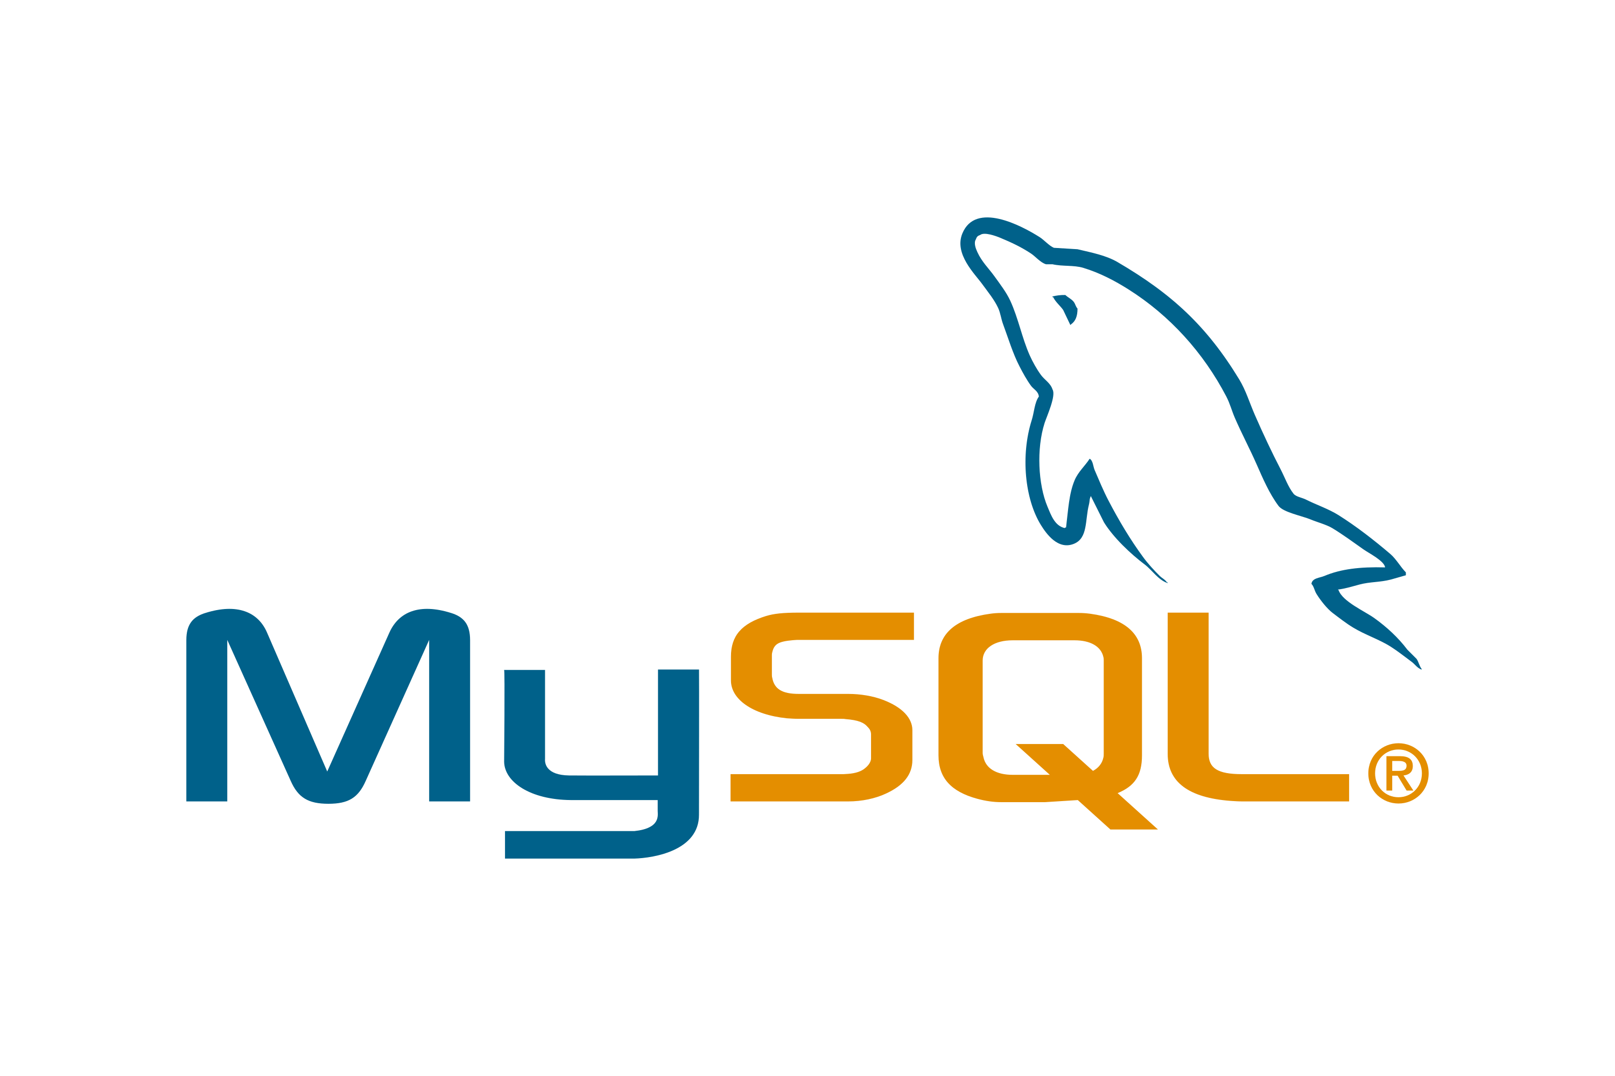

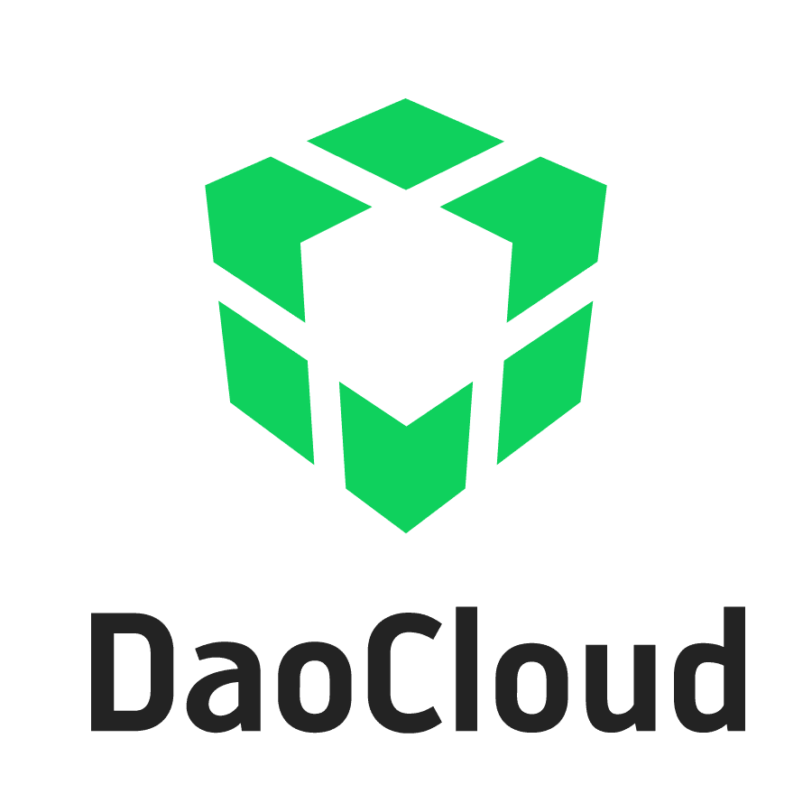

Enterprise switches
CloudEngine 6800
Enterprise Storage
Dorado 3000, 5000, 6000, or 8000
…
Enterprise compute stack
FusionServer 1288H servers
Cloud-native mission-critical applications
DaoCloud Digital X platform
VM
VM
VM
VM
VM
VM
VM
VM
Deployable on bare metal or VMs
3 master node HA deployment
DevSecOps tools
Application image repositories
Pod
Pod
Powered by OceanStor enterprise storage

Slide 15
Kubernetes Mission Critical Application Requirements
Application DR Requirements
App Granularity
App Consistency
Namespace Aware
Low RPO, RTO
Automation
Multi-Clouds
Add more
Snapshot
Multi-tenancy
Notes:
Kubernetes applications are container based, not machine based. To be effective, DR needs to happen at the container level too.
Modern applications are comprised of many containers running across many hosts. Recovering these applications without data corruption requires application-consistent backups, not simply volume snapshots.

Slide 16
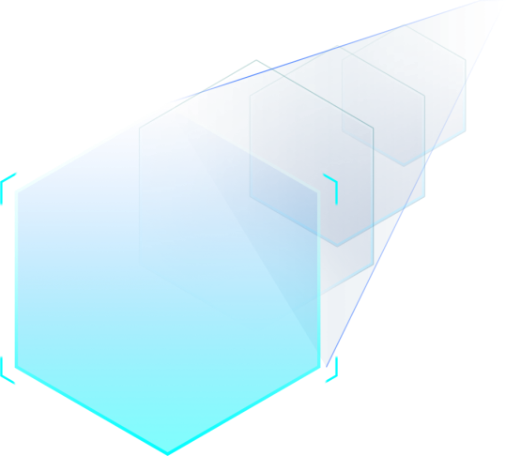
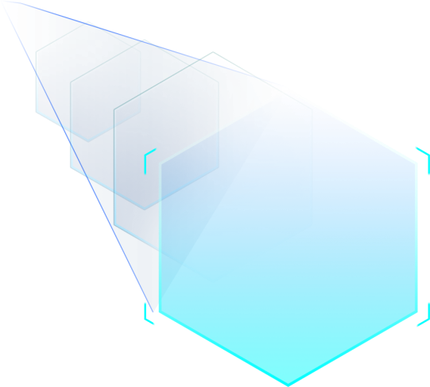


Redefine Kubernetes Mission Critical App Disaster Recovery
Redefine
Data Mobility
Redefine
Data Management
App Data Separate
Multiple Data
Redefine
Reliability
Redefine
Performance
Compute Storage Silos
Data goes with App
Multi-Clouds
App Centric Data Management
Commodity Storage
Commodity Storage
One Data
Redefine QoS
%99.99999
Enterprise, All Flash
Manual Recovery
Large RTO RPO
Automatic
Consistency
RPO=0, RTO in mins

Slide 17
DR Solution
Cloud Mesh
Cloud Mesh
APP K8S CFG
APP
DATA
APP K8S CFG
APP
DATA
Cloud Engine
Cloud Engine
CSI
REST
REST
CSI
REST
Storage System
Storage System
CLI & GUI Control
PV
Volume
Storage Replication
PV
Volume
PV Volume
PV Volume

Slide 18
Two DC Deployment
Cloud-native apps
Cloud-native apps
Primary production center
Sync or async replication
Secondary data center

Slide 19
Three DC Deployment
≤100KM
Intra-city data center
HyperMetro / Async
Remote data center
＞100KM
Async
Primary production center

Slide 20
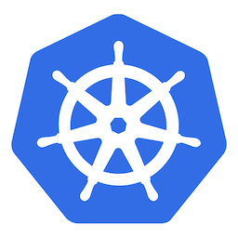

Migration
…
Native K8s apps
Cloud-native mission-critical applications
DaoCloud Digital X platform
Kubernetes platforms
VM
VM
VM
VM
VM
VM
VM
VM
Pod
Pod
Powered by OceanStor enterprise storage
Public clouds

Slide 21
OceanStor Introduction
DaoCloud introduction
OceanStor + Digital X Synergy
OceanStor, DaoCloud Digital X, and the digital journey
Opportunities and Challenges
DaoCloud Rack solutions
OceanStor-Digital X
Rack Solution

Slide 22
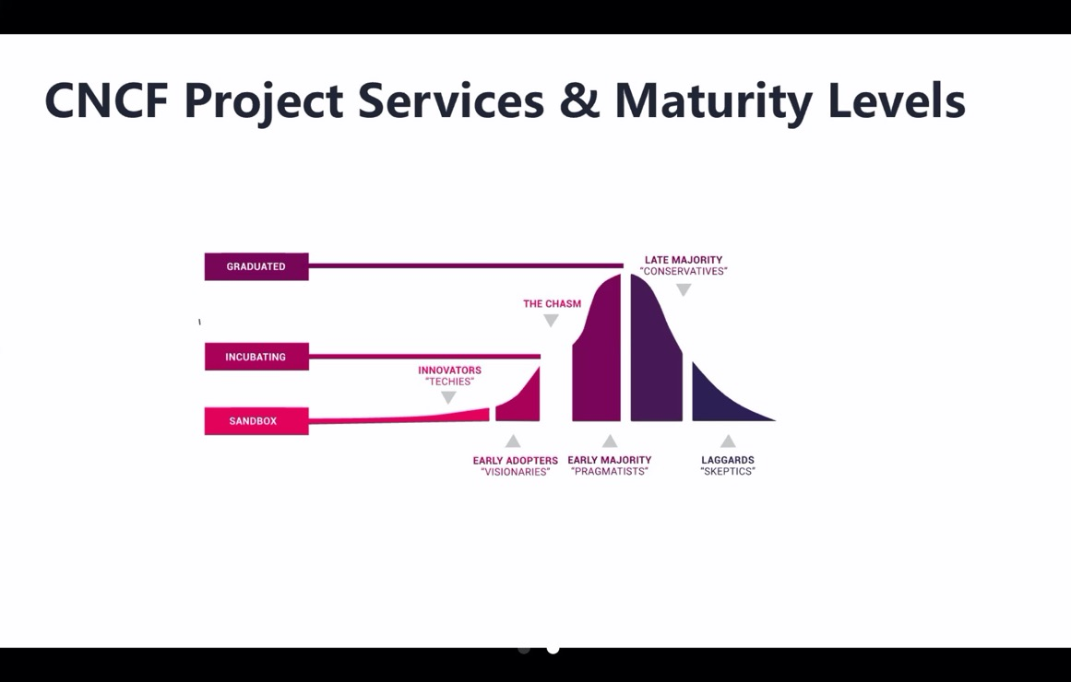
Customer Success Path - The Digital Journey
L2：Platform promotion (key milestones)
Value load promotes customer interaction goals
Process
DevOps
Architect Microservices
DaoCloud
The process of establishing new rules and standards in a logical order.
Focus on cloud-native architecture and create value load
Cloud Container
L3：System Standard (agility, awareness, security and data)
L1：Production ready (success service)
Plug into DaoCloud container platform
L4：Open and Capable
(wider and deeper level of integration, joint venture sharing)
L0 ：Application cloud (product service)
The Chasm
Deepening the stage of industrial digital strategic cooperation
Application Containerization Consulting Service

Slide 23


































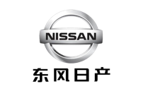

















DaoCloud Customers
Finance
Automobile
Manufactory
Energy
Retail
Security / Funds
Automobile
IOT
Government
Education

Slide 24





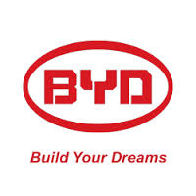































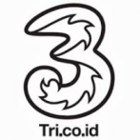




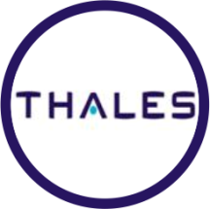











OceanStor: Trusted by 15,000+ Global Customers
Finance
Carrier
Large
enterprise
Media
Energy
Education

Slide 25


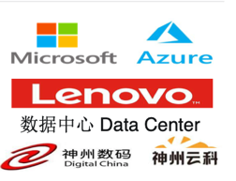











2020
About DaoCloud
2019
Over 100 million Round D
Digital Transformation
¥100M Round C
Industrial Cloud Platform
2018
Science and Technology Little Giant
2017
Near ¥50M Round B
Innovative Technologies
Shanghai Science and Technology Little Giant Enterprise
2016
2015
$10M Round A
Several ¥10M Round A+
Hybrid Cloud Digital Platform Strategic Alliance
Strategic Alliance with Kylin Software
Launched public cloud service
Joined CNCF
DaoCloud Enterprise 2.0
Strategic Alliances
Property and retail
territory
2014
Forrester 2015 Top Public Cloud in China
SPD Bank Science and Technology Community Partnership
IDC Innovator 2017
Founded in Nov. 2014
Strategic Partnership
Contribution no. 11
CNCF Ambassador
云原生计算基金会大使
Open source maintainer for Docker Swarm project
Red Herring Asia Top 100 Winner
First six CNCF KTPs worldwide
Strategic Alliance
German Hannover Trade Fair
Forbes Under 30 Elite List
$5M Seed fund
Strategic Partnership

Slide 26



Hybrid Cloud Digital Platform
Digital X Cloud
In-store Platform
E-commerce Platform
Cloud Collaboration
Microservices Governance
Agile
API
Scrum，CICD，Dashboard
Cloud Mesh
Access Control
Service Publishing
Quality
Property
Unit，Integration，Acceptance
Customer
Basket
Promotion
Registry & Discovery
Delivery
Transaction
Product
Order
Service Audit
Package，Configuration，Env.
Traffic
Stock
Logistic
Configuration
Cloud Engine
Realtime & Grayscale
Security
Version & Audit
Vulnerability，DevSecOps，Audit
Cloud Infra
Monitoring
Public Cloud
Tracing Analysis
Observation
Bare Metal
Virtualization
E2E Panorama
Monitoring，Logging，Tracing
Servers in the Physical Data Center
VMware/OpenStack Private Cloud
Different Public Cloud Providers

Slide 27















DaoCloud Openness and Open-Source Contributions
COLLABORATION SUITE
MESH PERCEPTION
CLOUD ENGINE
CLOUD OPERATION
Maintainer
MINIKUBE
#
7
Istio
#
10
CoreDNS
#
3
Kubeadm
#
2
PMC
Maintainer
HELM
#
10
Skywalking
#
5
Docker
#
10
Kops
#
3
PMC
VITESS
#
13
Apollo
#
7
CNI
#
14
Prometheus
#
9
Envoy
#
25
#
10
Kubespray
#
21
Reviewer
Kubernetes
#
12

Slide 28
DaoCloud Digital X Platform Technology Stack Panorama
Open API Ecosystem
Microservices
Artificial Intelligence
Microservices Framework
Governance
Service Mesh
Open API
Tracing
Analysis
Lifecycle
Health & Scaling
Configuration
Orchestration
CICD Pipeline
Quality Automation
Monitoring
& Logging
Dev
Collaboration Loops
Image
Perception
Security
& Audit
Ops
Container
Dynamic
Network
Data
Persistent
DevSecOps
Multiple Cluster
Multi-Cloud Operation
Private Cloud
Multi-Cloud
Bare Metal
Edge Computing
Infra
Heterogeneous

Slide 29
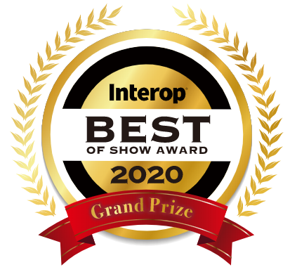
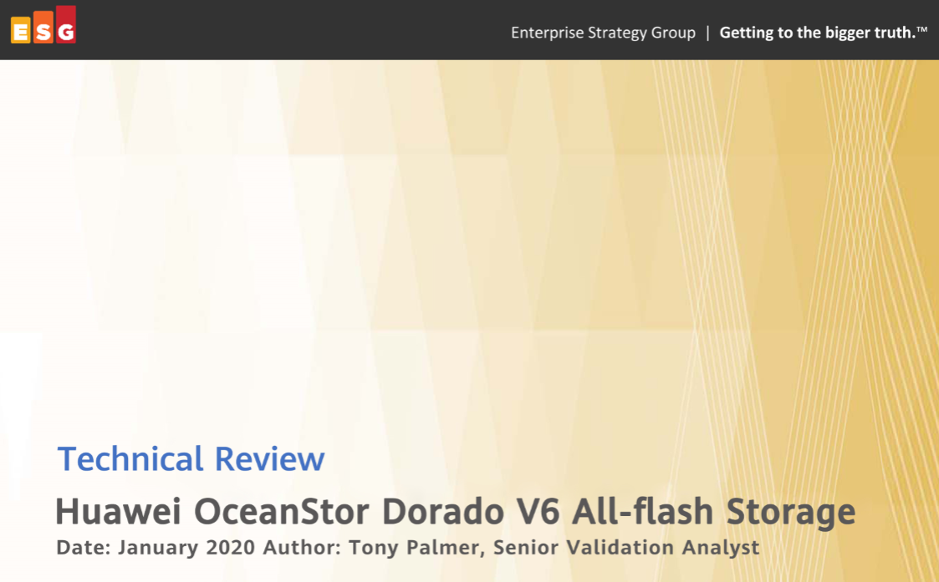
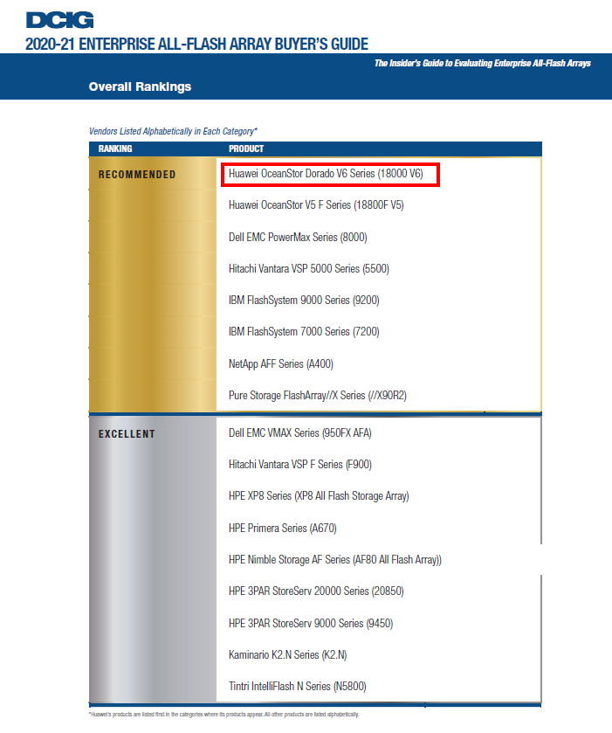
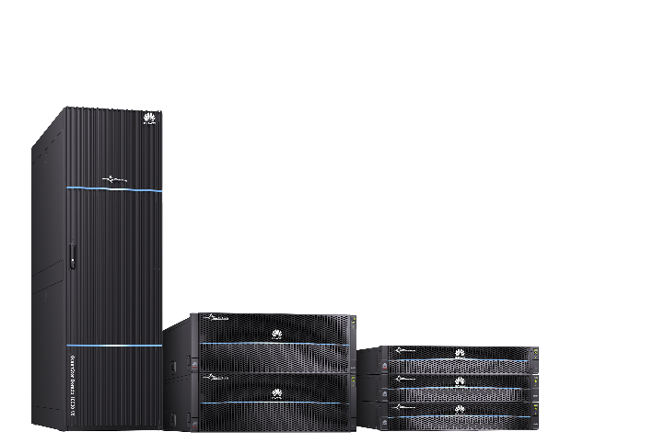
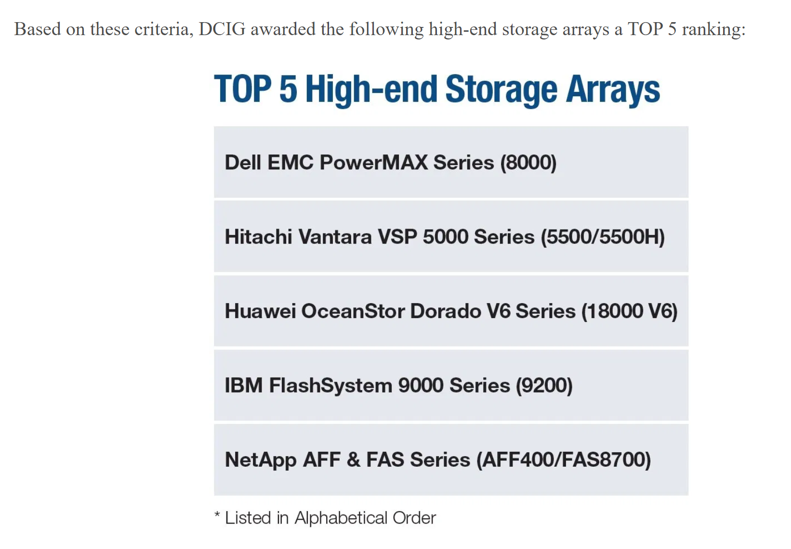



Huawei All-Flash Storage Gains Industry Renown
Interop Grand Prize
The Server & Storage category
Verification by the ESG Lab
Easily handles heavy-load enterprise apps
Ranked Recommended by DCIG
Listed in Top 5 High-end Storage Array List
Notes:
Interop -- A major event for global business technology that recognizes the most competitive products
ESG -- A well-known IT consulting organization that is renowned for its independent, rigorous, and practical laboratory tests
DCIG -- A global IT consulting organization known for extensive analysis and objective reviews in enterprise storage and cloud computing

Slide 30
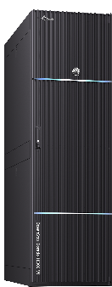
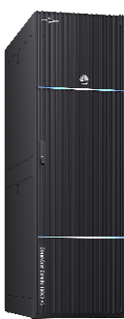
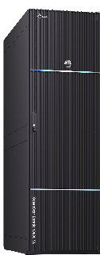
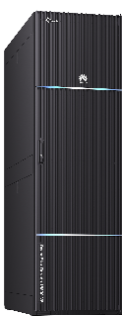
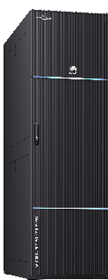
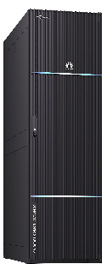
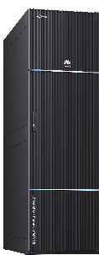
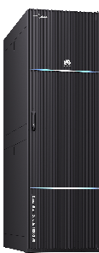
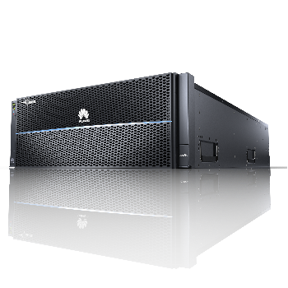
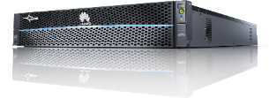
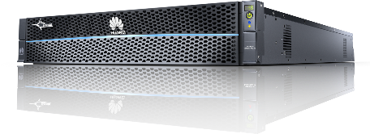
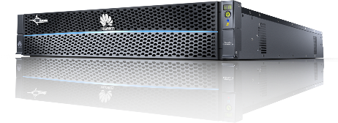
OceanStor™ Dorado Overview
Entry-level
Mid-range
High-end
18000
8000
6000
3000
5000
6-9 enterprise reliability
SAN/NAS converged
Enterprise features

Slide 31



Ever Fast
Ever Solid
AI-Powered
SPC-1 record holder
Fully connected SmartMatrix
Full life-cycle management
21M IOPS and 0.05 ms latency
30% higher NAS performance than industry average
Tolerates failure of 7 out of 8 controllers
AI-enabled O&M

